Slide 1



SDF11 Porfolio Piece
19/04/2024 | Matlhogonolo Cedrick Monare

Slide 2
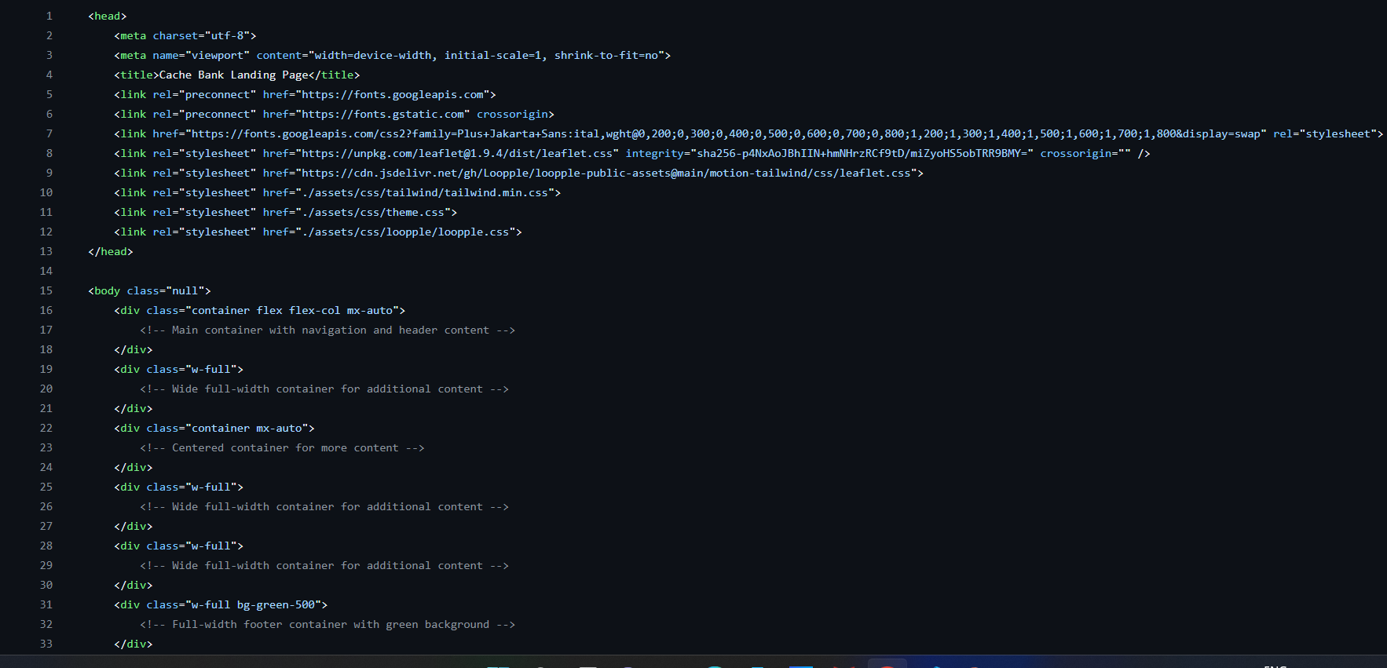
Presentation Outline for "Cache Bank" Portfolio Piece
Slide 1: Introduction
Good morning, good afternoon and good evening to whoever may be watching this. My name is Matlhogonolo Monare more commonly known as Cedrick, and this is my SDF11 portfolio piece. In this project we had to create a bank landing page with different elements such as navigation bars, hamburgers for mobile, hero’s and footers etc. The objective for this project was to help us showcase our web development skills and also make understand how to make user friendly websites while also making them responsive.
I used different tech stacks such as HTML, Tailwind CSS and some Javascript.
On my right is the initial starter code that we had to clone

Slide 3
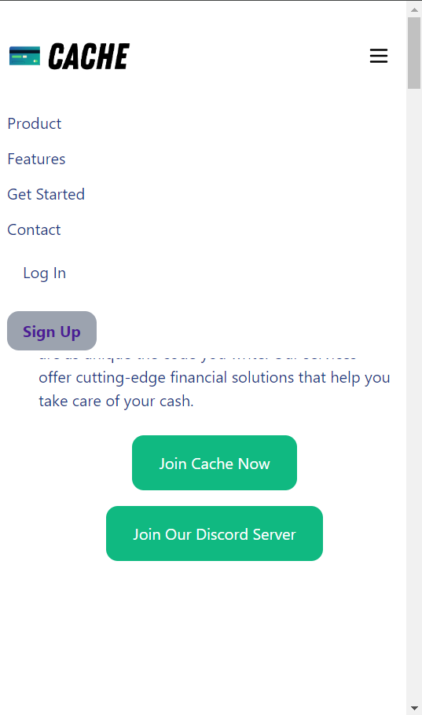
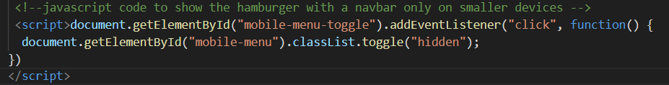
Slide 2: Component 1 - Project Setup and Responsive Navigation
The Mobile –First-Design is extremely important as it allows us web developers to start product design for mobile devices first. I was struggling a bit with using the media query for the mobile device so I ended up finding another method using JavaScript where the hamburger will only be visible on smaller devices such as a phone as shown on the right. >>>
I used elements such as flex, padding and width so the page is able to be resized depending on the screen size of the user. My JavaScript code to show the hamburger only on mobile is also down below.
I used semantic HTML SO I could improve the structure and readability of my code and also to enhance accessibility

Slide 4
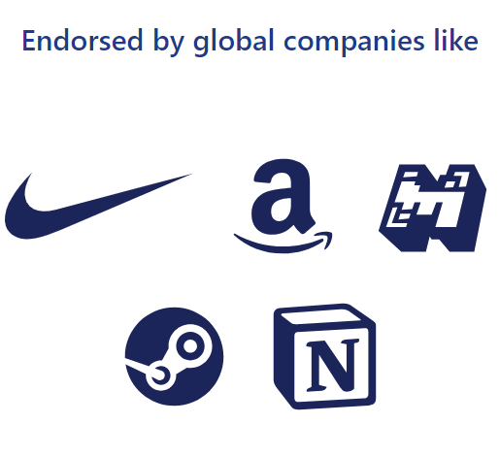

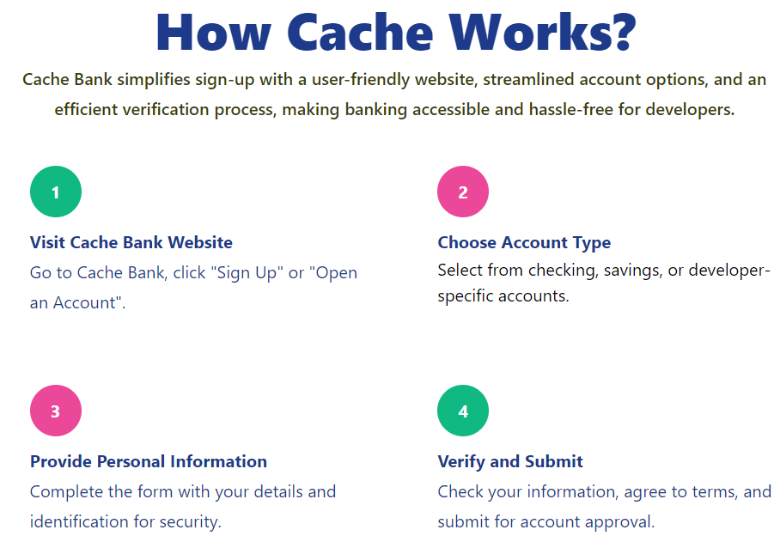
Slide 3: Component 2 - Hero and Endorsements
Incorporating endorsements from reputable sources can serve as social proof, indicating to potential customers that your product or service is trustworthy and of high quality. When people see that others, they trust endorse your offering, they're more likely to feel confident in choosing it. It can also enhance your own reputation. It shows that you're recognized and respected within your industry, which can attract more customers
The call to action in the hero section is a gateway for users to engage further with your product, service, or content.
For my Hero Section I used a bunch of tailwind classes such as text-blue and font-extra bold for my styling and I used some grids, grid columns, flex, padding and margins to align everything correctly as shown below.

Slide 5
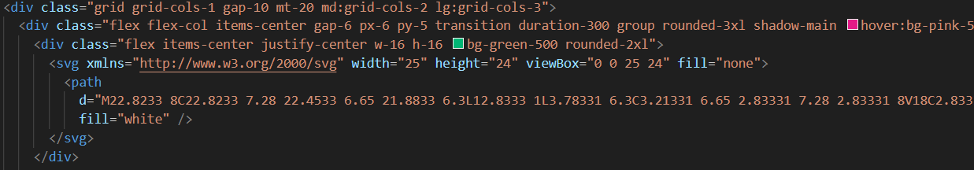
Slide 4: Component 3 - Features
CSS Flexbox and Grid are very important tools when it comes to responsive design for instance with flexbox you can easily control the spacing between features and how they wrap to the next line as the screen size changes and with grid it is more deal when designing layouts with multiple rows and columns and allows for more precise control over the placement of features, including their size and alignment. Below is an example of them working together
Applying ARIA roles appropriately can ensure that users with disabilities can navigate and interact with the content effectively for example when Improving Screen Reader Compatibility using the alt tag in an image.

Slide 6
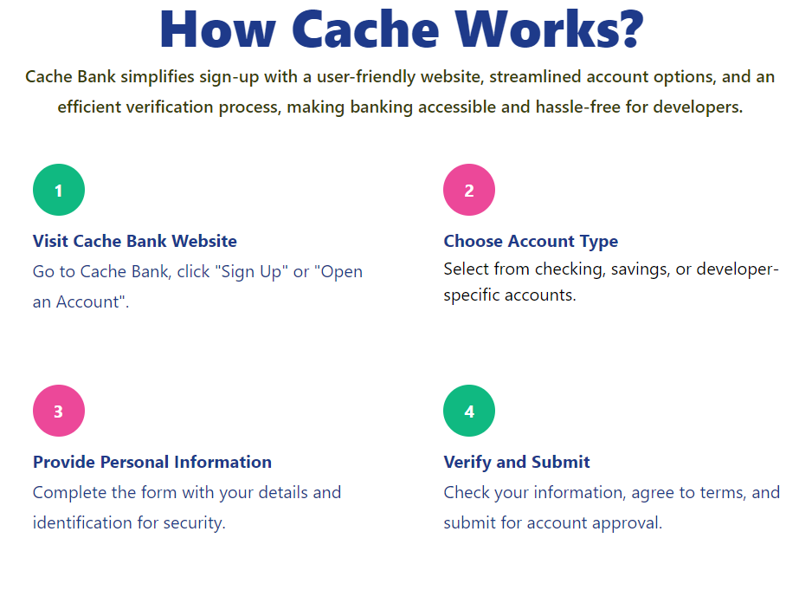
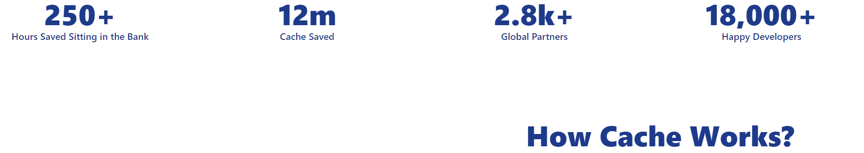
Slide 5: Component 4 - Stats and Getting Started Section
The 'Getting Started' section design is extremely user friendly and appealing with different colors and good font which would make any client interested in signing up
I used text-3xl, font-extrabold and a text-blue of 900 to make the heading and the stats nice and bold with a blue colorway, I feel like the blue is very appealing and is more likely to get people’s attention since it looks very professional. Discuss the CSS layout techniques used to make the 'Getting Started' section and statistics visually appealing and informative.

Slide 7

Slide 6: Component 5 - Contact and Footer
My footer has a clear and organized Layout, it has readable text and I made sure that my links are accessible, I even added my own personal social media links and changed the color to brown to match the green footer. The green also compliments the websites entire design as it is mostly has pink, blue and green colors.
Flexbox helps to move certain elements underneath one another if a smaller device is being used which makes the page responsive to any device.

Slide 8
Slide 7: Conclusion
We had to create a bank landing page with different tech stacks and elements. I feel like I utilized every tech stack and element to the best of my ability. In every component I had a few struggles since I had to use different elements for different things, but I eventually managed to successfully use every tech stack and element on every component
I learnt a lot about Tailwind in this project as it was basically the main component and I feel like my problem-solving and documentation skills increased throughout this project.
Thank you for your time and have good day forward

